Slide 1
Leveraging BlackBerry Services: BBM and Scoreloop
JAM 847
Nick Kalkounis – Product Manager
Mark Sohm – Developer Relations
Vaideeswaran Sethuraman, CEO, Divum
Chethan Rao, Divum
November 29-30, 2012

Slide 2
For More Information…
Come to the Lab! JAM 849 - BBM Integration in the NDK and WebWorks (Today @ 1pm)
http://developer.blackberry.com/bbm
Let us know about the cool things you’ve done!
nkalkounis@rim.com - @nickkalkounis
msohm@rim.com MSohm in the BlackBerry Developer Forums

Slide 3


Agenda
Scoreloop
BlackBerry Messenger
Social Platform

Slide 4
Scoreloop
The Games App
The Games App is the social gaming hub where BB10 users share and discover new players, games and achievements.
The preloaded Games App provides fantastic visibility for all developers with Scoreloop enabled games.
Scoreloop SDK
Scoreloop SDK leverages social gaming APIs to incorporate features like leaderboards, challenges, achievements and integrates into the Games App.

Slide 5
















Scoreloop Reach
Scoreloop connects games and the people who play them.
13,000 game studios using Scoreloop SDK
1,300 games
182m users
29m MAU
2.8m DAU
Over 10b High scores

Slide 6
The Games App
The Games App is a preloaded application on the home screen of BB10.
As a central gaming experience on BlackBerry it enhances social and viral discovery of Scoreloop enabled games.

Slide 7
The Games App
The Games App feature overview
Connect with other BB10 gamers
Find friends on BBM
Discover your friends’ games
See friends' gaming activities
Compare gaming skills with friends

Slide 8
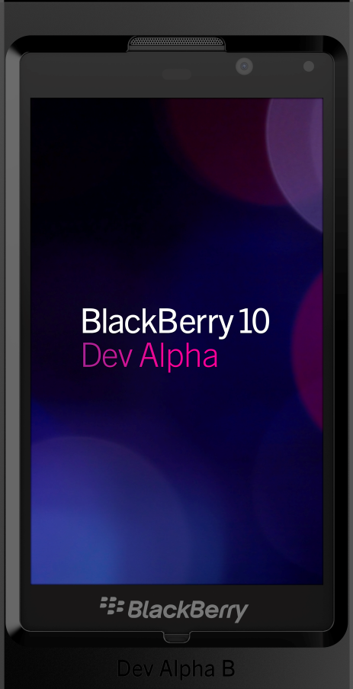
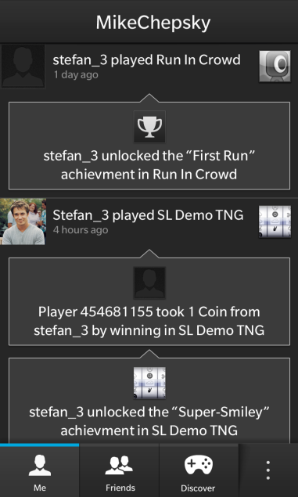
The Games App Features
See & Compare
See friends’ gaming activities.
Compare gaming skills with friends.

Slide 9

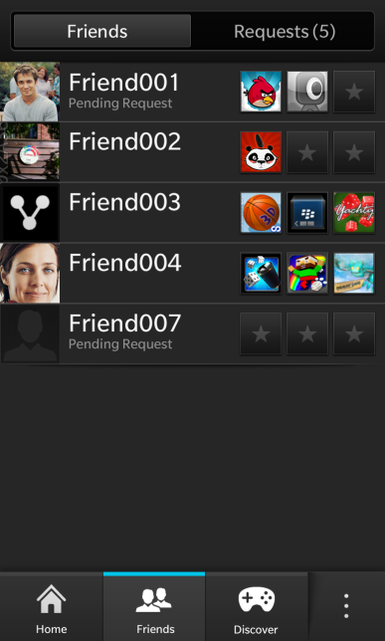
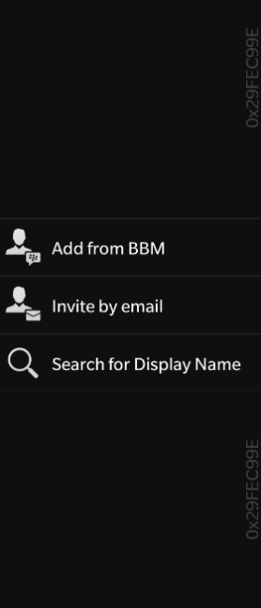
The Games App Features
Find
Find friends on BBM.
Other options available to find friends.
Choose from friends already playing and invite others.

Slide 10

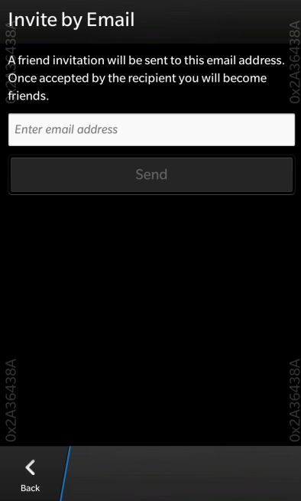
The Games App Features
Connect
Connect with other BB10 gamers.
Invite by email and add your BBM contacts.
Receive achievement and challenge news updates from friends and stay engaged.

Slide 11

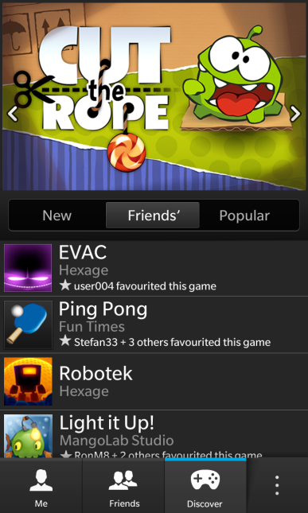
The Games App Features
Discover
Discover your friends’ games.
Find the most popular games, your friends’ favorites and all new social games.
Download directly from App World.

Slide 12
Scoreloop SDK
Integrate with the Games app for ultimate visibility on BB10
Make your game better with social features
Scoreloop SDK lets game developers integrate a set of social gaming features into their games.

Slide 13
Scoreloop SDK
Feature Overview
User profile
Leaderboard
Achievements
Challenges
Gaming data storage

Slide 14

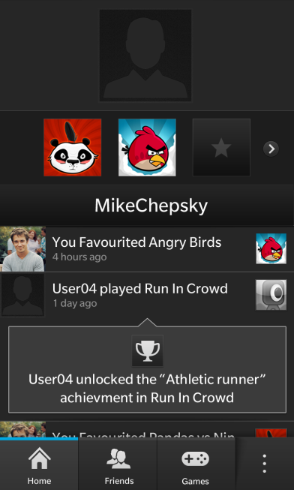

Scoreloop Features
User profile
Build a gaming identity that persists across games.

Slide 15

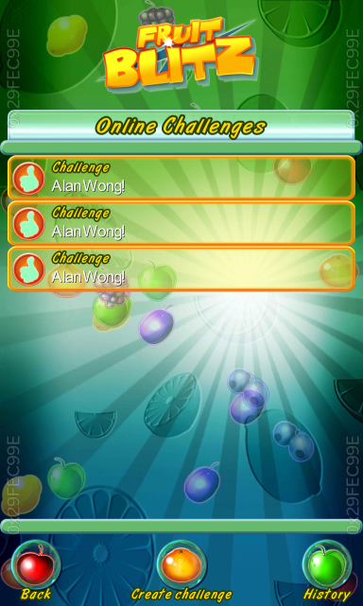
Scoreloop Features
Challenge
Challenge friends directly from within games.

Slide 16

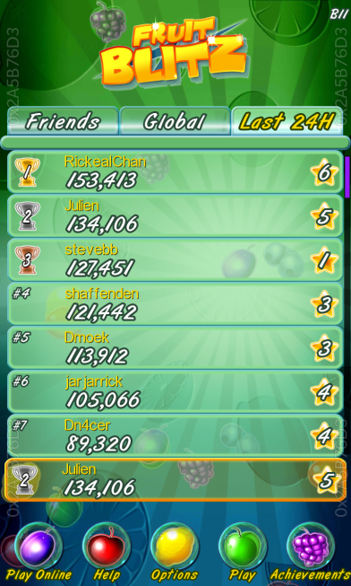
Scoreloop Features
Leaderboard
See global Leaderboards & your friends’ ranking.
Compare gaming scores and achievements and compete with BBM friends to see who is the best gamer.

Slide 17
BBM Social Platform
BlackBerry Messenger
Social Platform

Slide 18


BBM Agenda
$$$
developer.blackberry.com/bbm
What.
Why.
How.

Slide 19
BBM: A Vibrant Social Network
60 Million+ Monthly Active Users
2 Million+ New users every month
70% of BBM users use BBM daily
> 150B messages sent/month
+1% of Apps are BBM Connected
…But they make up 20% of App World Downloads!
Notes:
Number was 56M in May

Slide 20






The BBM Social Platform
Discoverability
App Stickiness
Engagement
Monetization

Slide 21
BBM Social Platform APIs
Available Now!
BBM Contact List & Invitations
User Profile Updates
Application Box Updates in User Profile

Slide 22
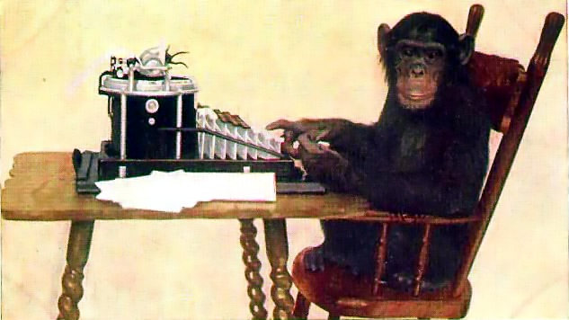
Is it hard to use?
developer.blackberry.com/bbm
Source: By New York Zoological Society (Picture on Early Office Museum) [Public domain], via Wikimedia Commons

Slide 23
BBM Social Platform APIs
BlackBerry 10
C BlackBerry Platform Services (bps) APIs
Add to existing applications using bps
Qt style APIs
Integration with Cascades applications
WebWorks APIs
BlackBerry OS 5-7
Java APIs
WebWorks APIs

Slide 24
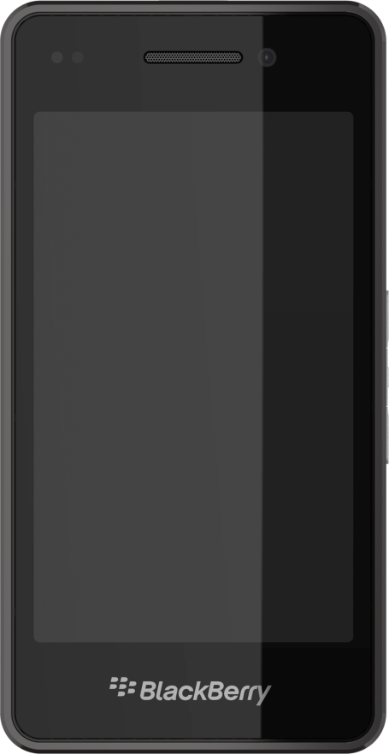
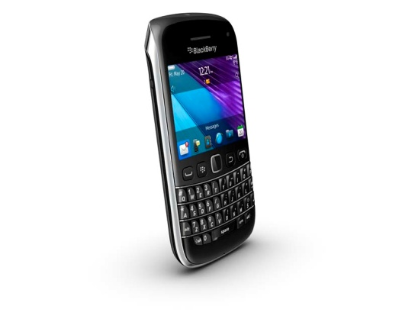
BBM Social Platform APIs
Use the BBM SP seamlessly between BlackBerry 10 and BlackBerry OS 5-7!
BBM Social Platform
IMPORTANT – Use the same SKU in App World!!!

Slide 25
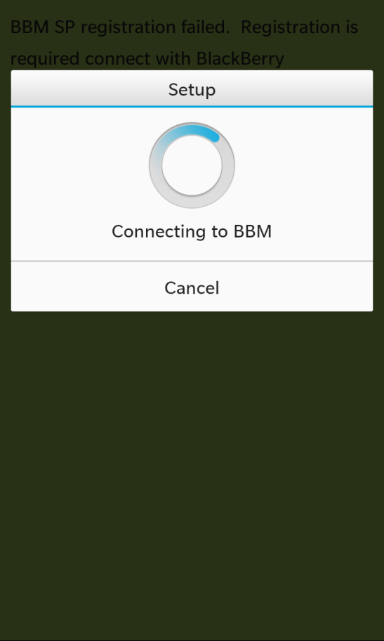
BBM SP Registration
First step for any BBM Social Platform application
User must allow the registration
User can enable/disable BBM SP access at any time

Slide 26
BBM SP Registration
//TODO: Define your own UUID. You can generate one here:
// http://www.guidgenerator.com/
QString m_uuid = QString::fromUtf8("c0fef20e-5f94-4eb1-be1e-e055f2c2391c");
bb::platform::bbm::Context* m_context = new bb::platform::bbm::Context(QUuid(m_uuid));
QObject::connect(m_context, SIGNAL(registrationStateUpdated(bb::platform::bbm::RegistrationState::Type)),
this, SLOT(registrationStatus(bb::platform::bbm::RegistrationState::Type)));
m_context->requestRegisterApplication();

Slide 27
BBM SP Registration
//Receive Registration Response
void RegistrationHandler::registrationStatus
(bb::platform::bbm::RegistrationState::Type state) {
switch(state){
case bb::platform::bbm::RegistrationState::Allowed:
//Success!!!
break;
//… Also handle errors and pending states.
}
}

Slide 28
BBM SP Invite to Download
Users can invite their BBM contacts to download your app
Integrates directly with BlackBerry App World
Viral Distribution

Slide 29
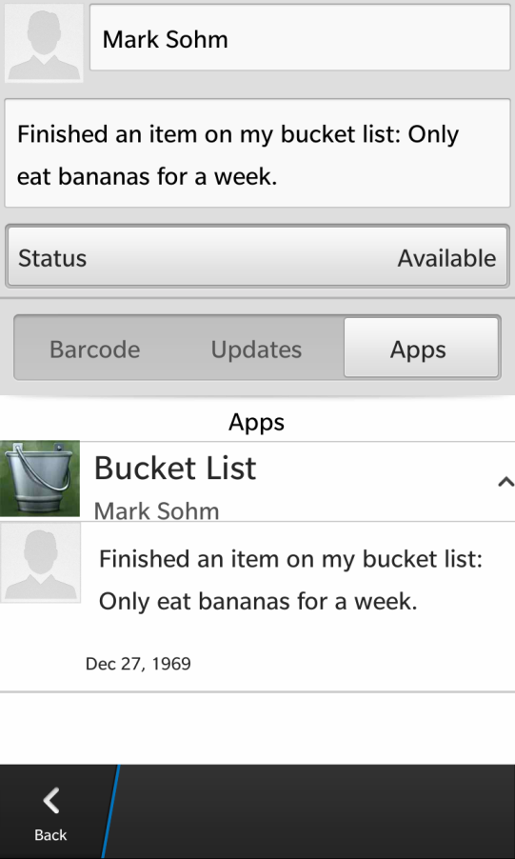
BBM SP Profile Boxes
BBM SP Connected apps are listed in a users BBM Profile
Add items within your app’s Profile Box
Achievements, high scores, current track, important news

Slide 30
BBM SP Profile Boxes
//Create a profile box with item
bb::platform::bbm::ProfileBox* m_profileBox m_profileBox = new bb::platform::bbm::ProfileBox(m_context, this);
m_profileBox->requestRegisterIcon(iconId[id],
bb::platform::bbm::ImageType::Png, iconArray);
m_profileBox->requestAddItem(QString(“New High Score: 2!"),
QString(iconId[id]), QString("cookie").append(iconId[id]));

Slide 31
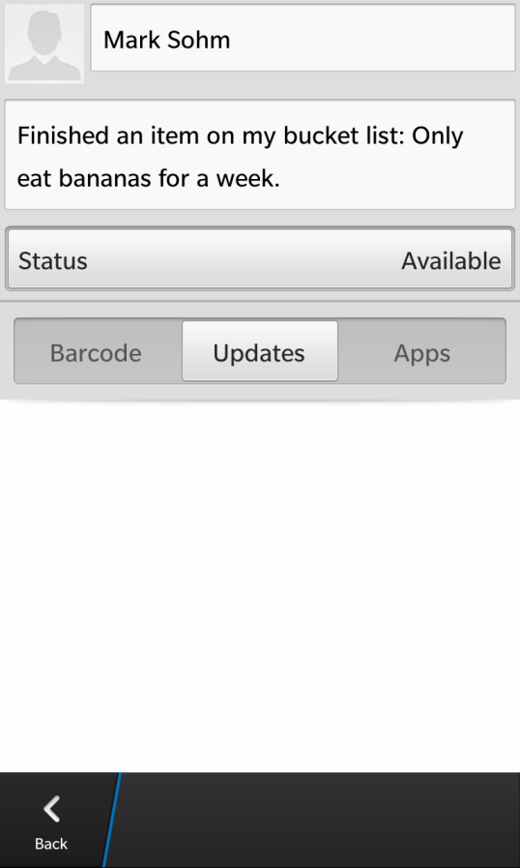
BBM SP Profile Page
Access and customize the users BBM Profile Page
Avatar Image
Status Message
Personal Message
Availability
Handle (read only)

Slide 32
BBM SP Profile Page
//Grab the user's Profile.
bb::platform::bbm::UserProfile m_userProfile = new
bb::platform::bbm::UserProfile(m_context, this);
//Update the user's personal message.
m_userProfile->requestUpdatePersonalMessage("New Message");

Slide 33
BBM SP Contacts
Obtain a list of BBM contacts that have the application installed and registered
Listen for changes to profiles of these contacts
Status change to -> “Wants to play SlingShot 5000 with someone”
Local app could prompt the user to start a multiplayer game

Slide 34
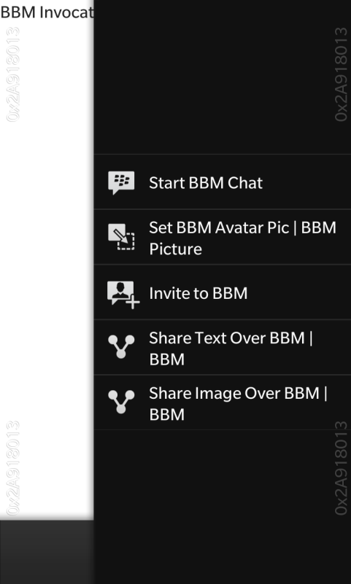
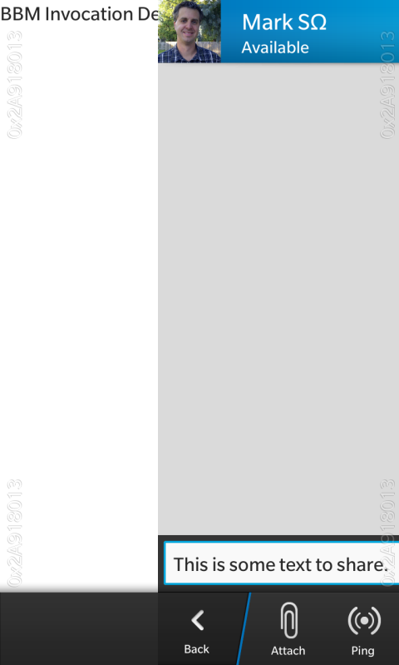
Invoking BBM
Use the Invocation Framework to Invoke the BBM Client to…
Start with specific contact(s)
Start chat, user chooses contact(s)
Set BBM Avatar Image
Invite Contact to BBM
Share Text with contact(s)
Starts chat with pre-populated message
Share Image with contact(s)

Slide 35


BBM SP Roadmap - Features
Feature | Native & Java Availability
 | BlackBerry 10 | BlackBerry OS 5-7
Registration
Profile Boxes
Profile Page
Invite to Download
Channels
Sessions
BBM Chat | Post BlackBerry 10 Launch
Invite to BBM | Post BlackBerry 10 Launch

Slide 36
BBM SP Roadmap - Features
Feature | WebWorks Availability
 | BlackBerry 10 | BlackBerry OS 5-7
Registration
Profile Boxes | Planning
Profile Page
Invite to Download
Channels
Sessions
BBM Chat | Post BlackBerry 10 Launch
Invite to BBM | Post BlackBerry 10 Launch

Slide 37
BBM SP Roadmap - Tools
Tool | Platform Availability
 | BlackBerry 10 | BlackBerry OS 5-7
Native SDK
WebWorks SDK
Java SDK

Slide 38
Real World Experience
Introducing Vaideeswaran Sethuraman & Chethan Rao from Divum
Our notable apps with BBM Integration
Scribbler for BBM
ScreensShare for BBM
Spot my Contact
Horoscope with BBM

Slide 39
PhotoBrowser
BlackBerry 10 Cascades application by Divum
Download magnificent images to your BlackBerry 10
Stunning hi-res images sourced from Pinterest from our custom server.
Share downloaded image with your BBM friends
Set Wallpaper
Share image and set wallpaper using NFC

Slide 40
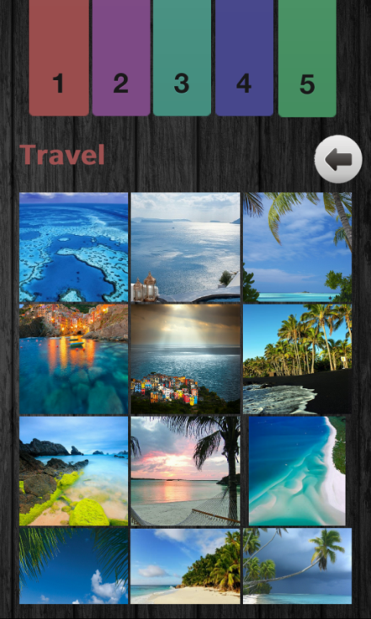
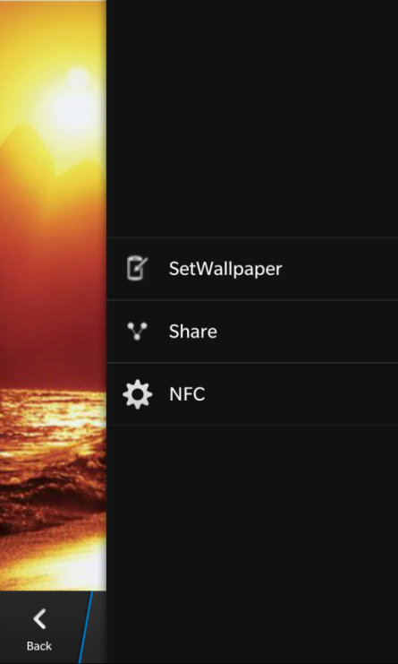
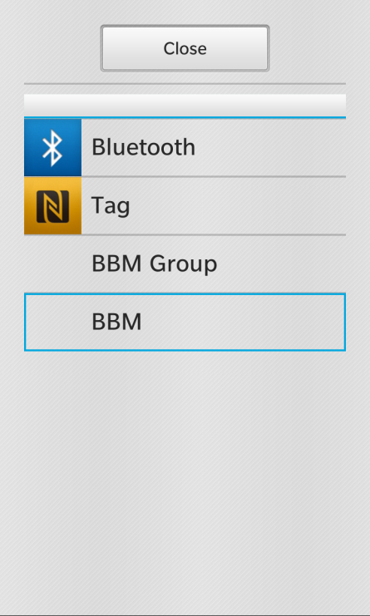
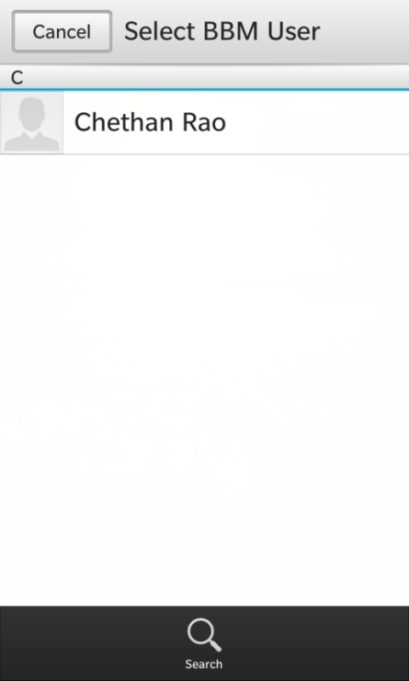
PhotoBrowser
(a)
(b)
(c)
(d)

Slide 41
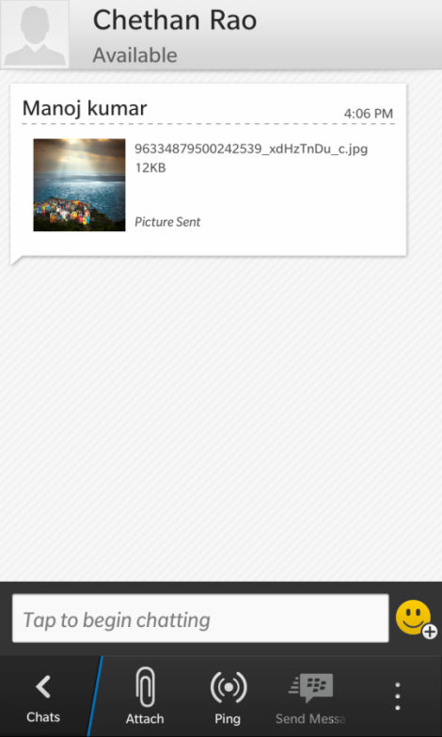
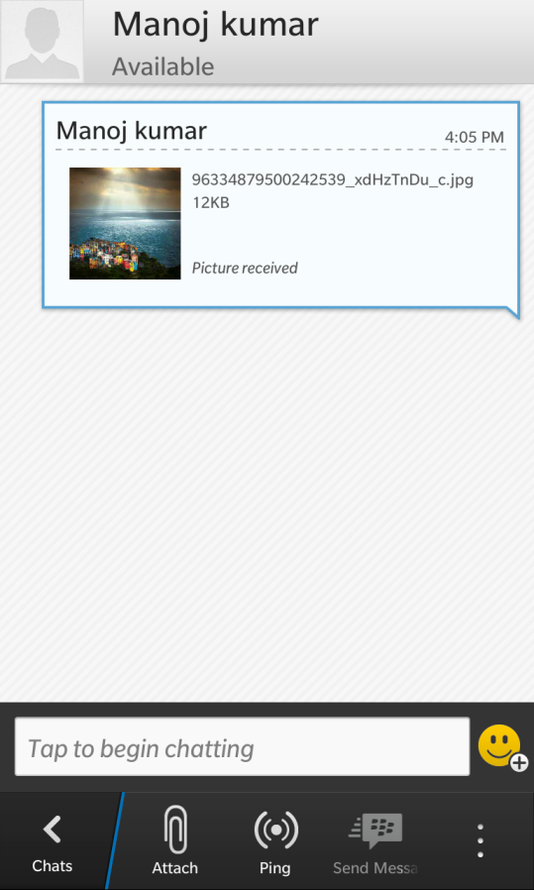
PhotoBrowser
PhotoBrowser is already live on BlackBerry AppWorld and can be downloaded to your DevAlpha Device today!!
http://appworld.blackberry.com/webstore/content/18920158
(e)
(f)

Slide 42
For More Information…
Come to the Lab! JAM 849 - BBM Integration in the NDK (Today @ 1pm)
http://developer.blackberry.com/bbm
We want to hear from you!
Let us know about the cool things you’ve done!
nkalkounis@rim.com - @nickkalkounis
msohm@rim.com MSohm in the BlackBerry Developer Forums

Slide 43
THANK YOU
JAM 847
Nick Kalkounis – Product Manager
Mark Sohm – Developer Relations
Vaideeswaran Sethuraman, CEO, Divum
Chethan Rao, Divum
November 29-30, 2012

